Slide 1
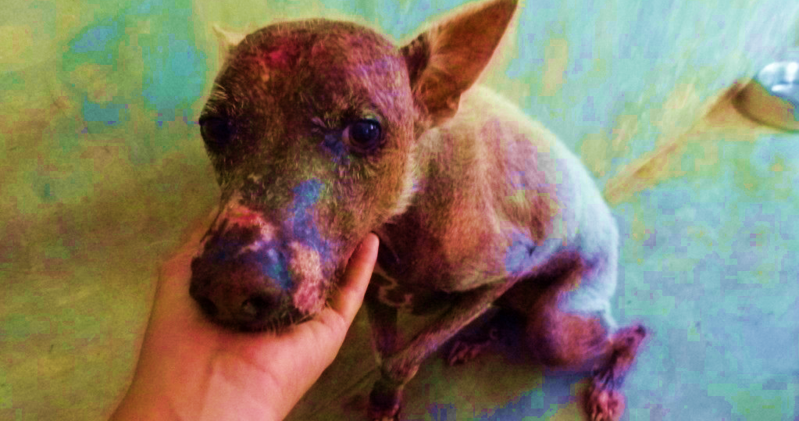
Online care system
Dog care system
Name: Dona Erangi Madushika Wanniarachchi
Module name: Final year project Presentation
Student ID: IAPLA2000362
Lecture Name: Mr. Palaniappan

Slide 2
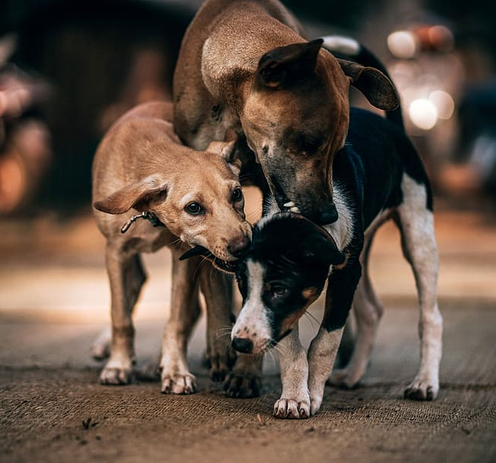
introduction
This project is about designing and implementing of website and web application for the “Dog Care system”.
“Dog Care System” is an Application and online store that We are trying to help the street dogs in need by working together with Dogee by introducing a Dogs Care system.
Dogee is one such organization in the world who is helping street dogs.

Slide 3
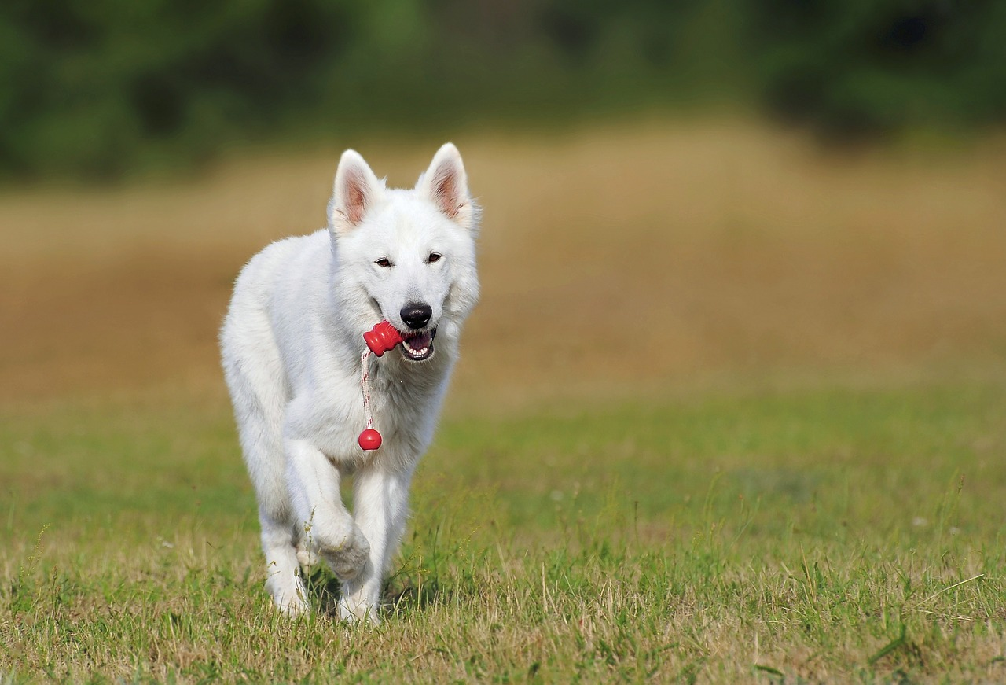
Project goal
To build a call tracking system using web technologies and a database that is highly usable in order to help the IT support department to better deliver support services.

Slide 4

Problem
Injury
threatening
Environment
A dog that is out on its own can cause a collision when it runs in the road, which might even result in injury to other people and also to itself.
Stray dogs often prefer to roam in packs and so it might cause a threatening feel and also result in superfluous and redundant puppies.
Stray dogs tend to defile and sully due to the fact that no one is available to look after it.
Effect of human
Target AUDIENCE
All the dogs are not gracious towards human beings and so there are chances that someone might get bitten if the stray dog is not controlled.
Dogee organization can prioritize their works according to the information they gathered.

Slide 5



Solution
LOVING PARENT
Target Audience
Our organization helps to find
Loving, caring and sharing parent to loneliness dog.​
People can send information through the mobile app and DOGEE Organization will collect those information and according to those information they will take necessary actions.
Easy to use
A simple product gives customers the information they need in order to service their hospitals with the right equipment​

Slide 6

WEB site
Programming Lanuges: css, html,javascript, mysql

Slide 7

Home page

Slide 8
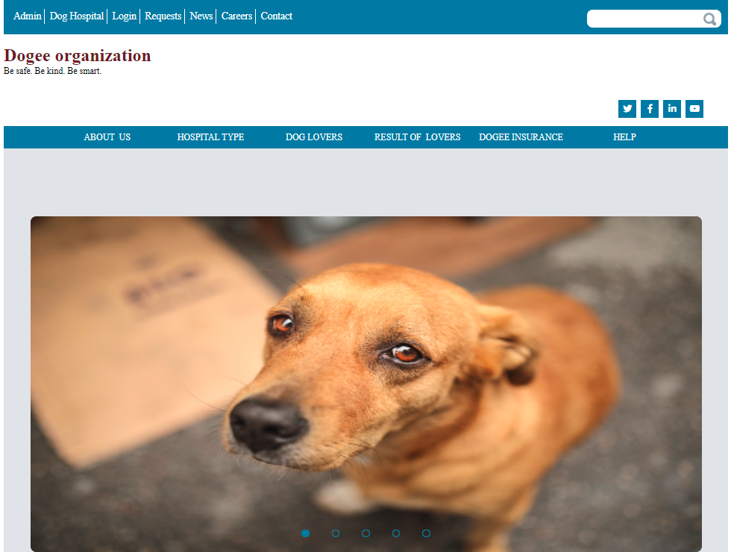

Slide 9
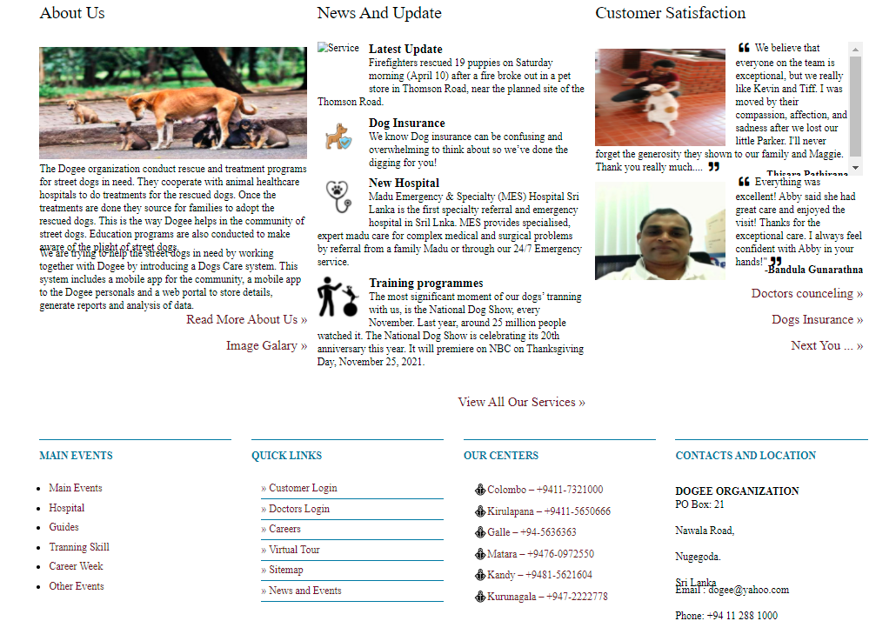

Slide 10
Bord of doctors

Slide 11
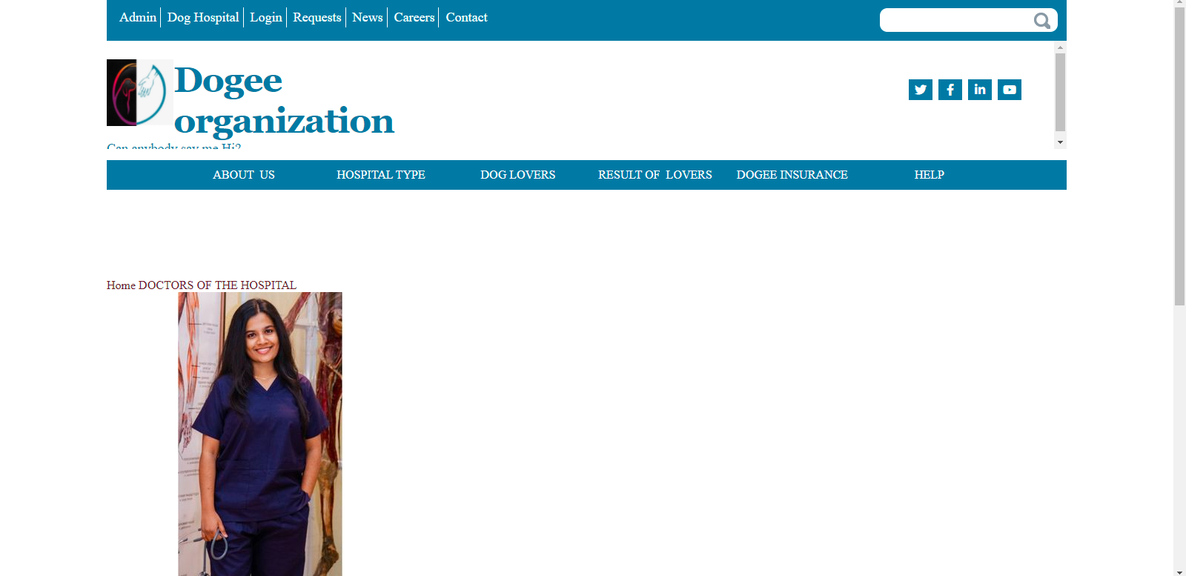

Slide 12
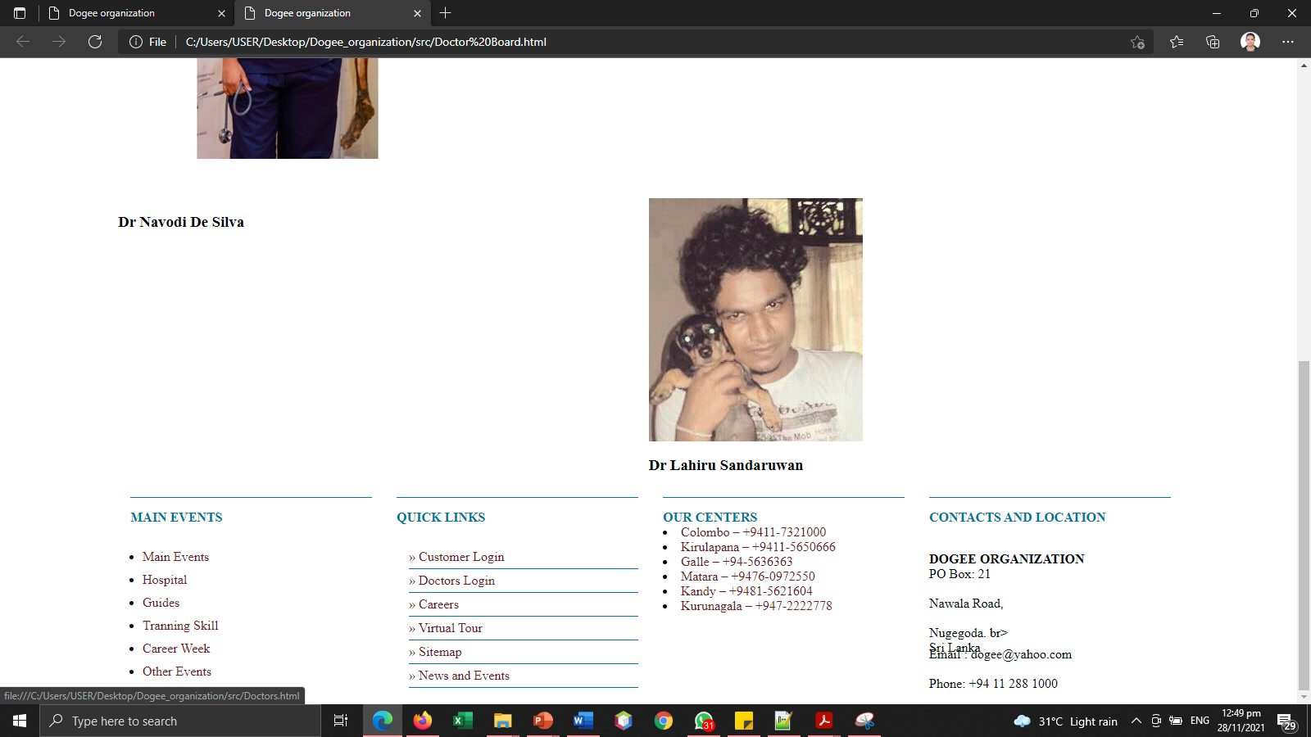

Slide 13
Doctor’s massages

Slide 14
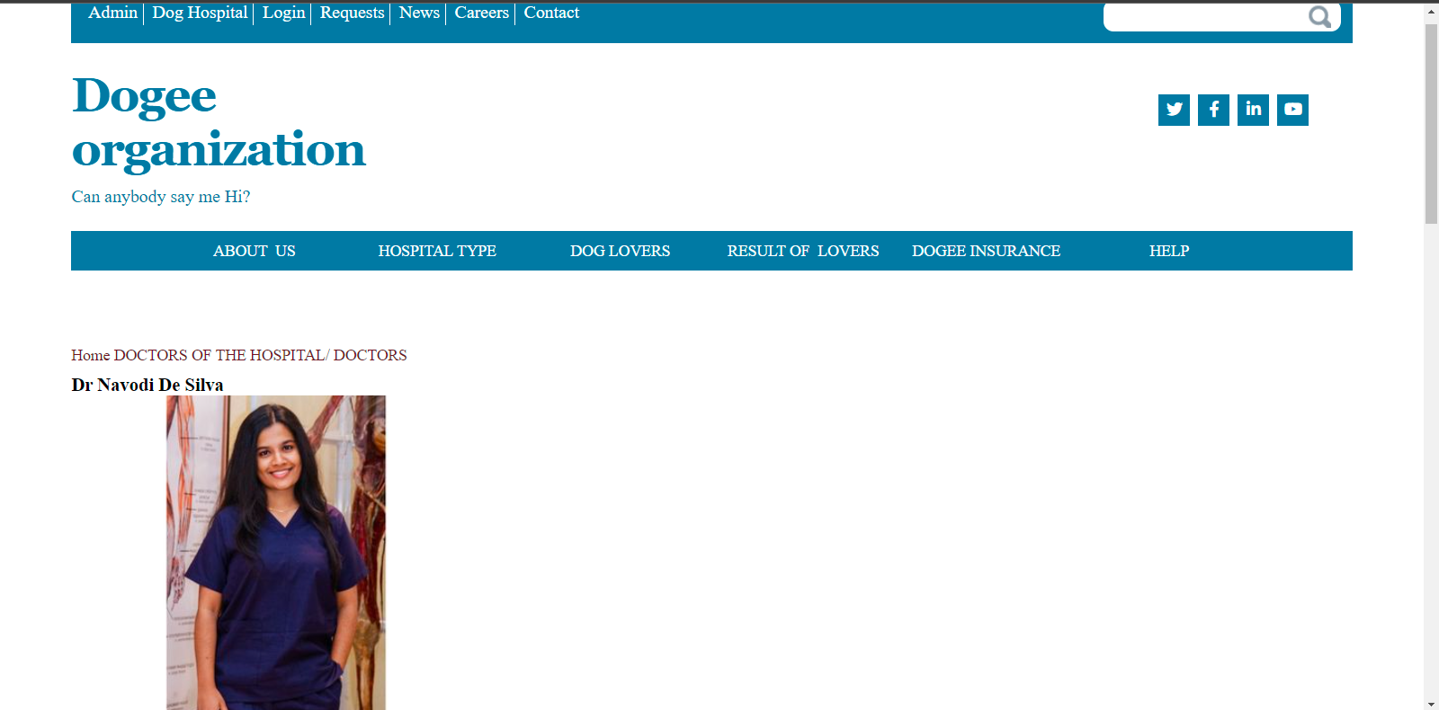

Slide 15
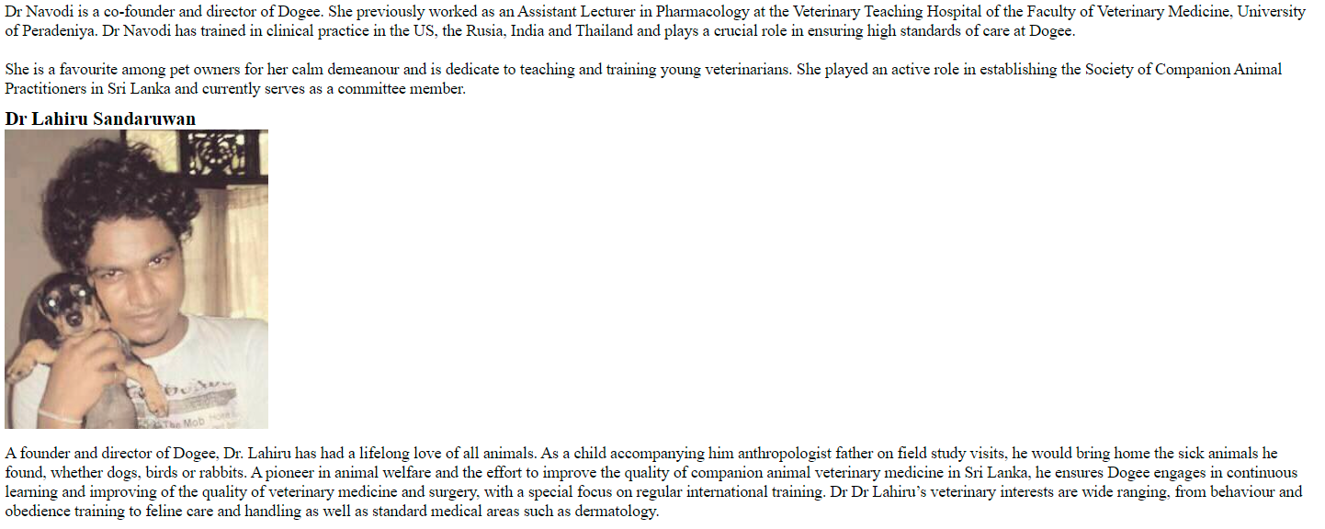
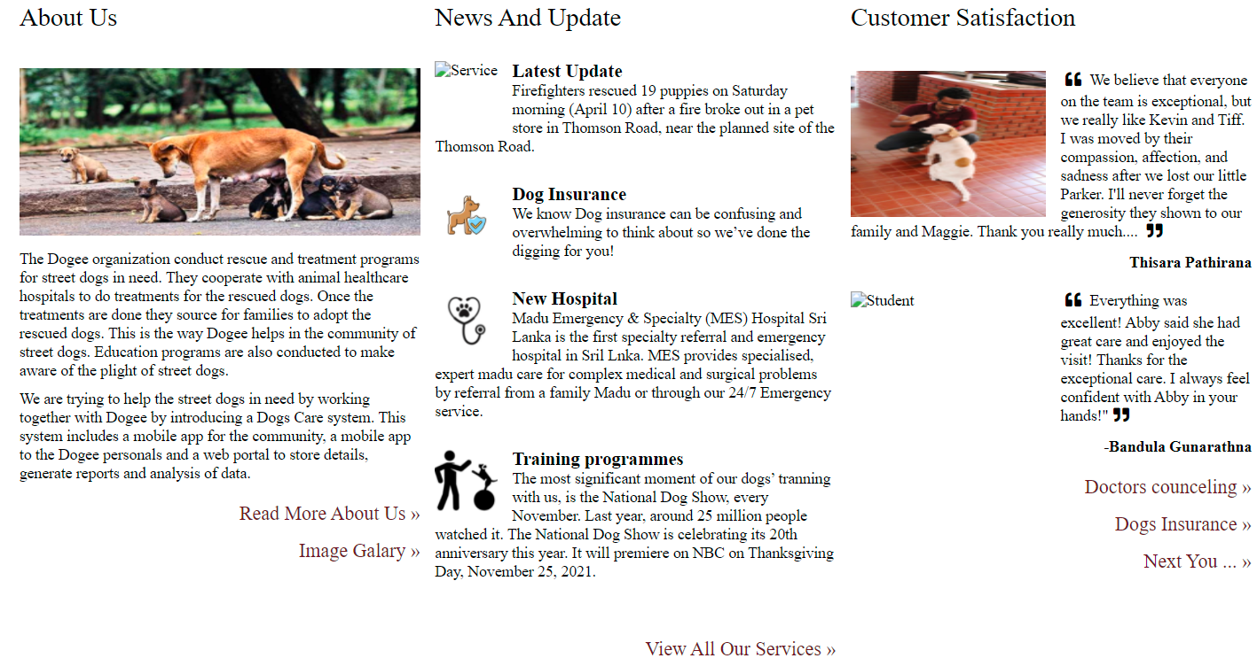

Slide 16
Clink page

Slide 17
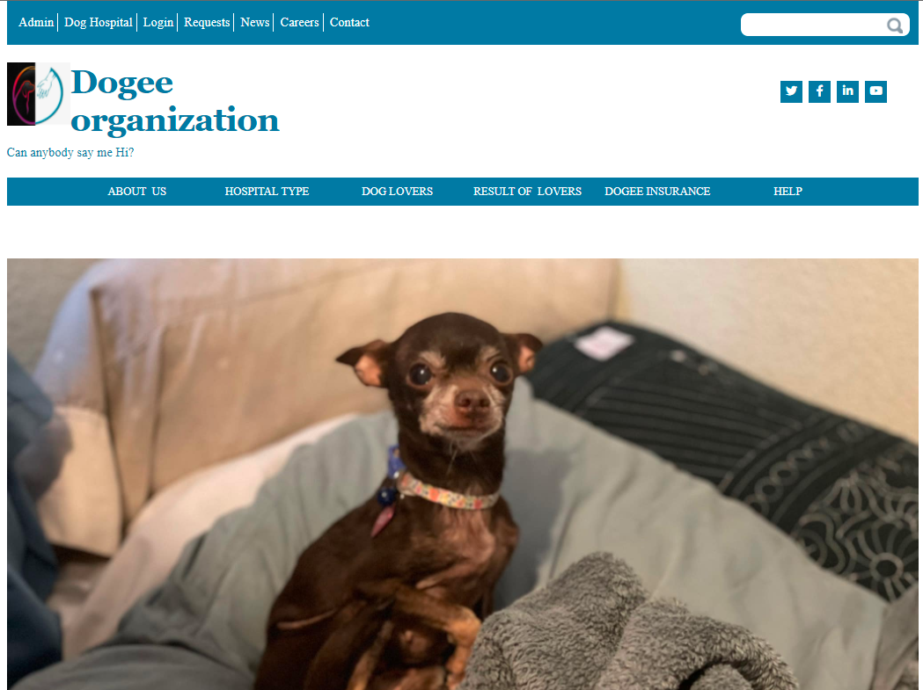

Slide 18
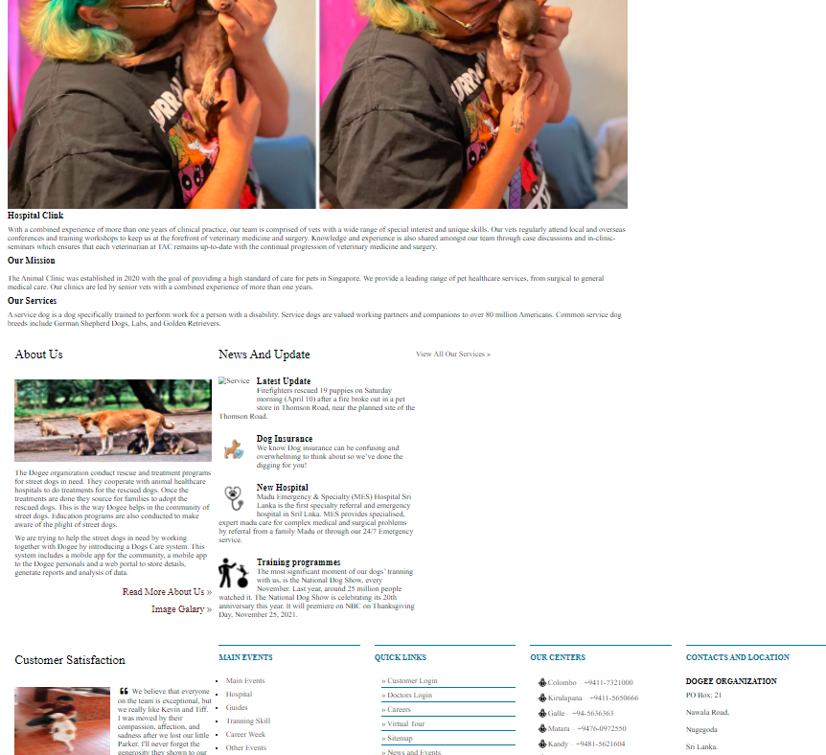

Slide 19
Physical training page

Slide 20
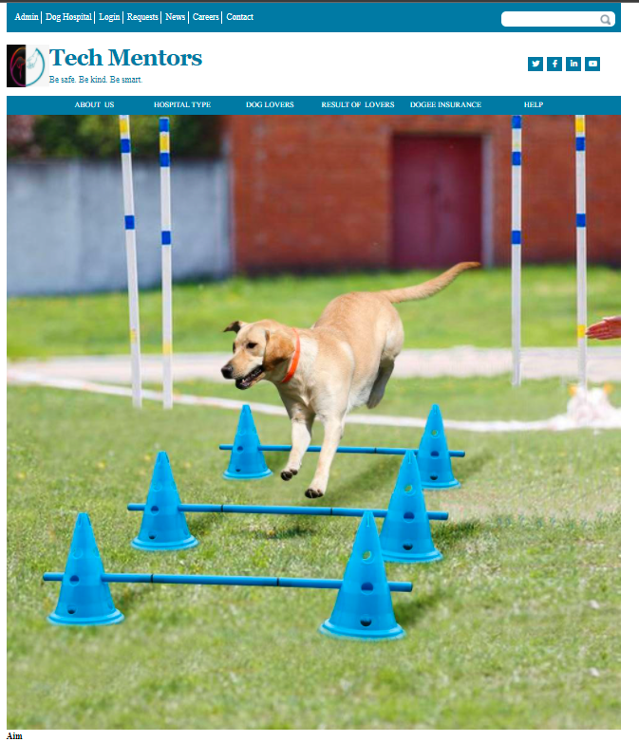

Slide 21
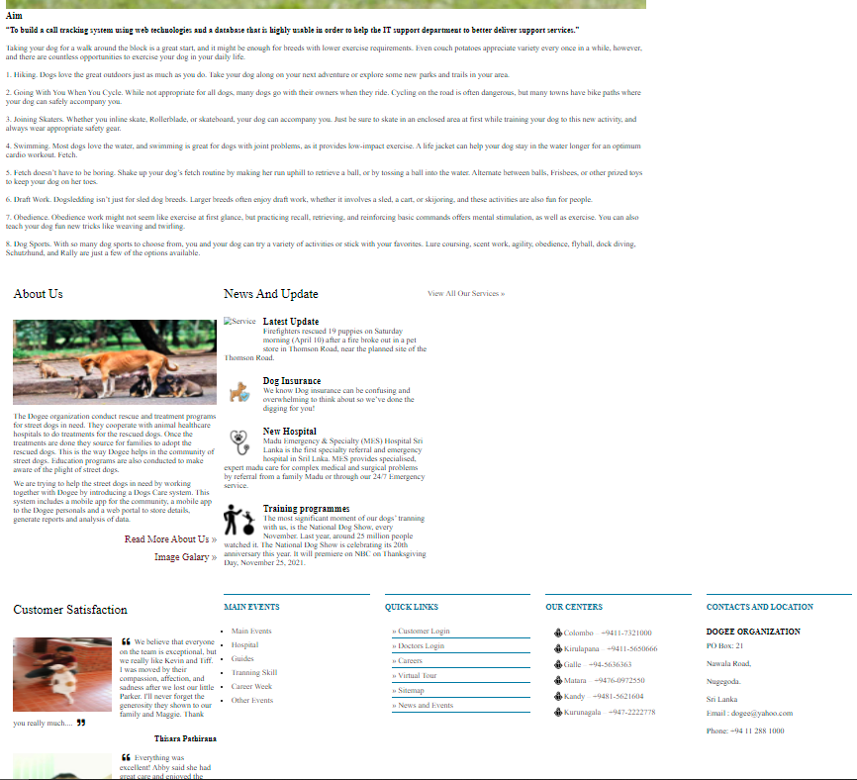

Slide 22
parent details

Slide 23
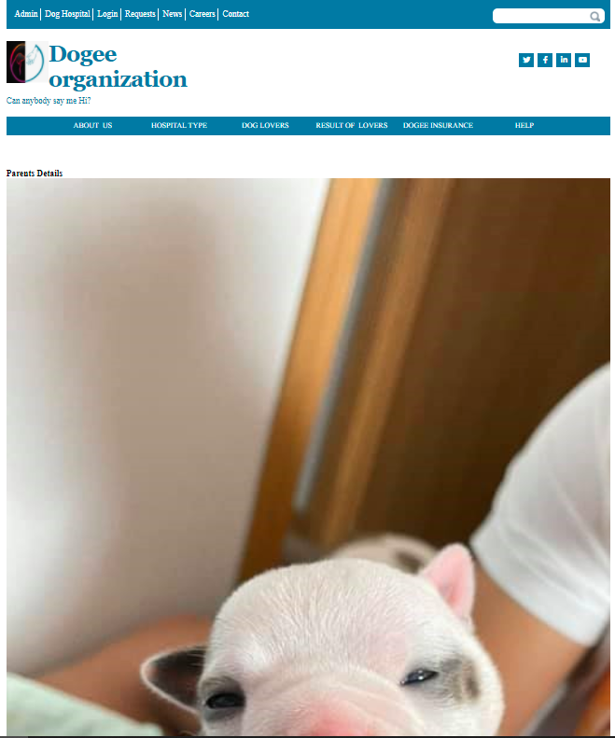
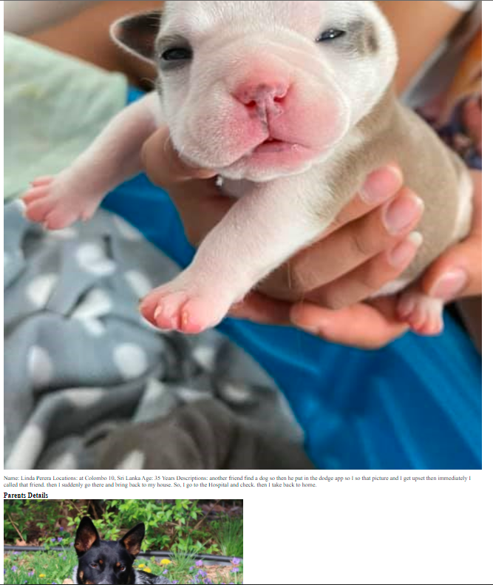

Slide 24
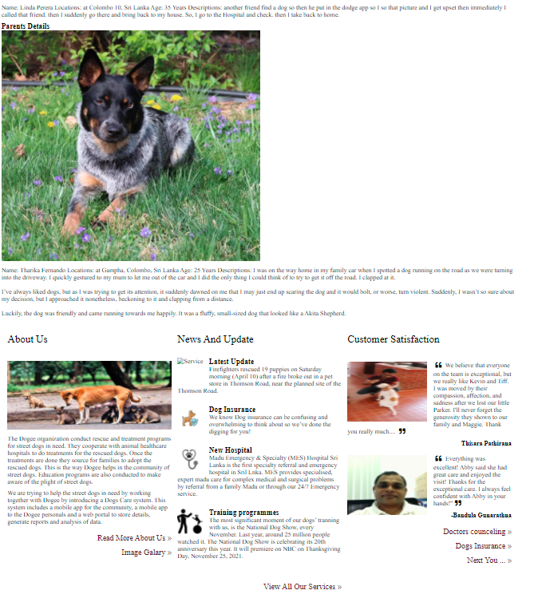
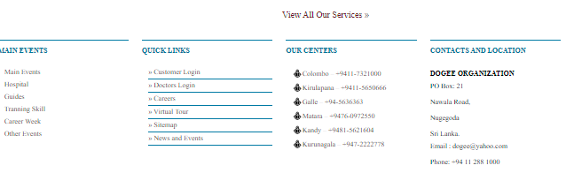

Slide 25
Dog Type

Slide 26
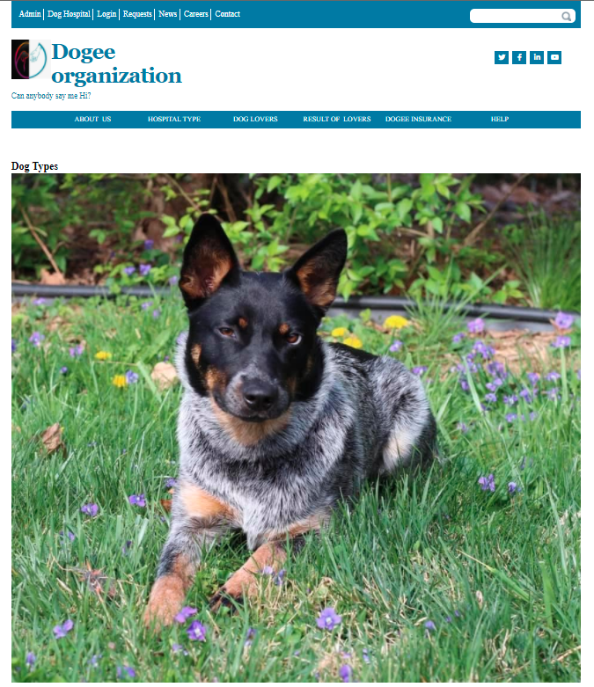
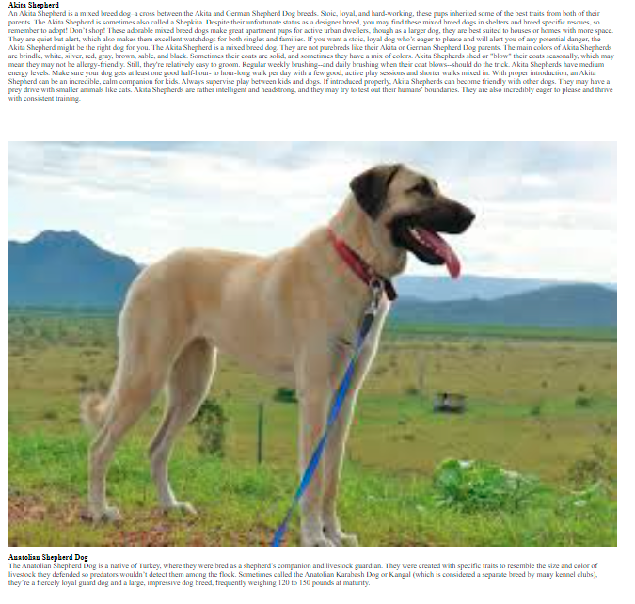

Slide 27
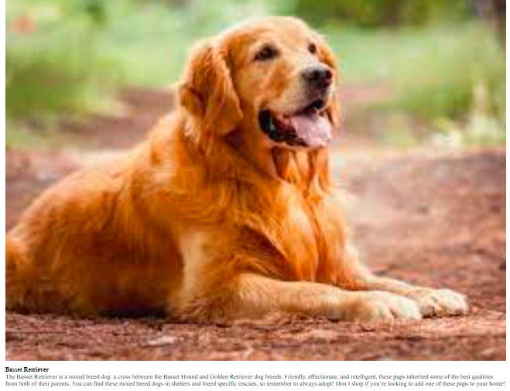
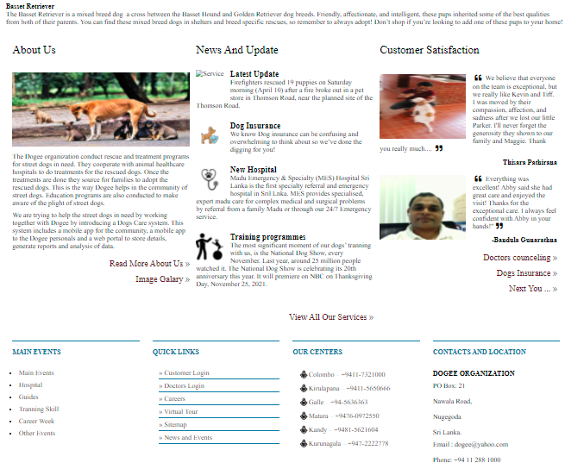

Slide 28
Problem's page

Slide 29
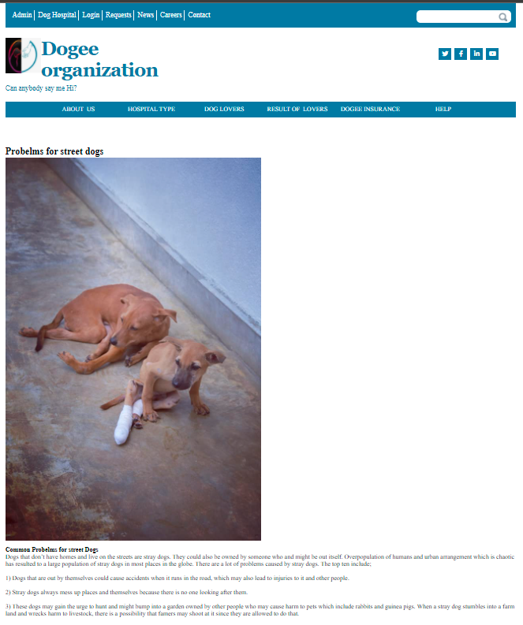

Slide 30
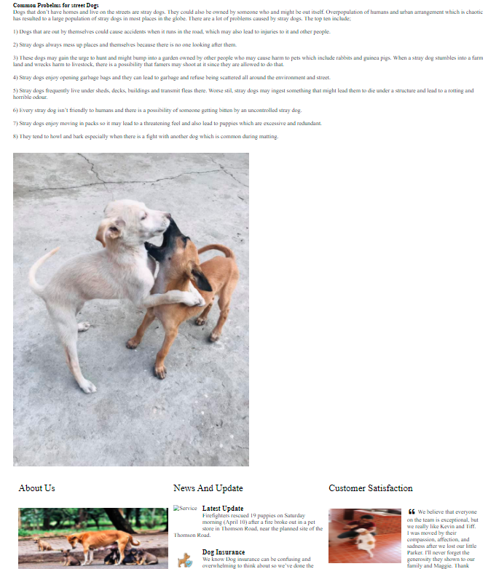

Slide 31
Solutions page

Slide 32
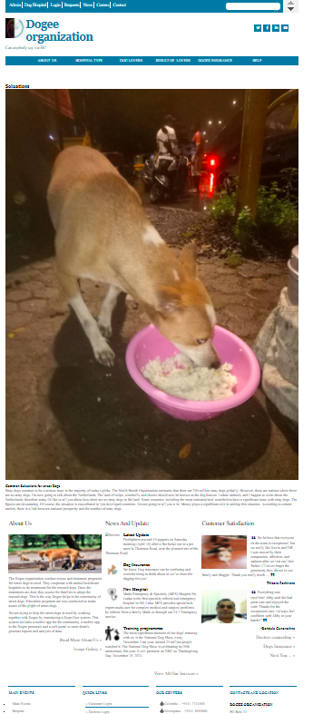

Slide 33
Important of the Insurance page

Slide 34
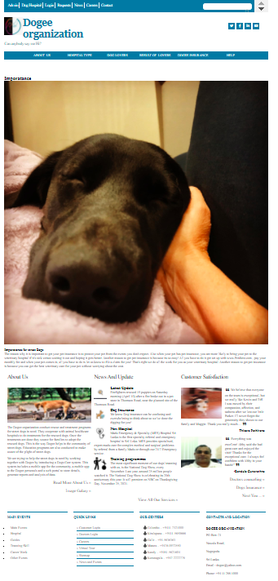

Slide 35
Lifetime Cost page

Slide 36
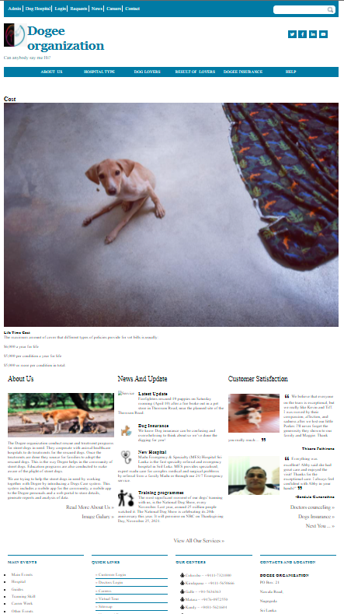

Slide 37
WEB APPLICATION
Using Software: PHPStrom 2021.2.3 version
Programming Lanuges: php,html,javascript, mysql

Slide 38

LOGIN page

Slide 39
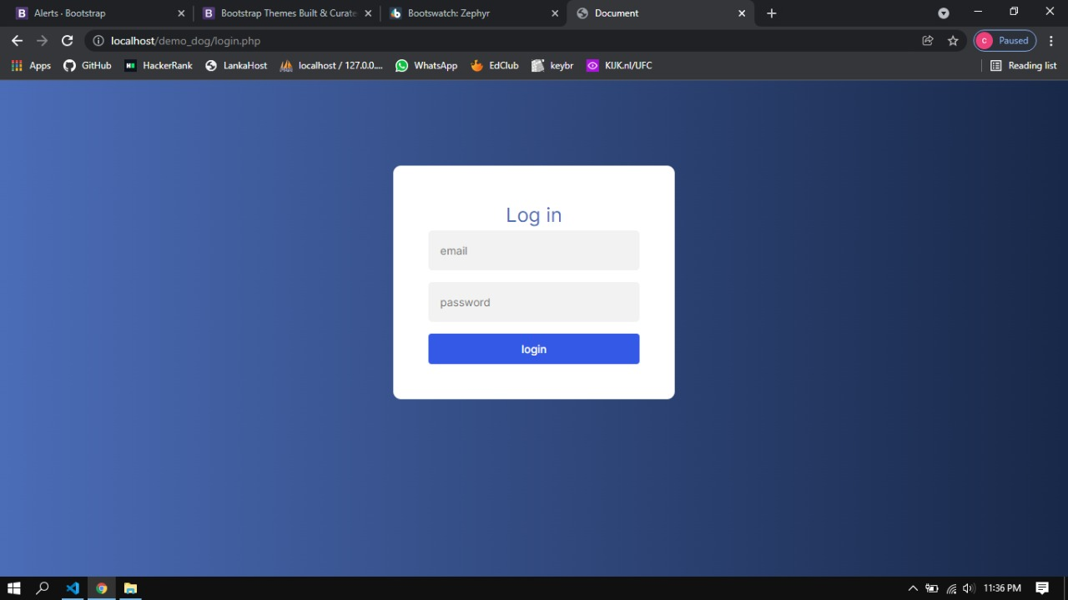

Slide 40
Add dog page

Slide 41
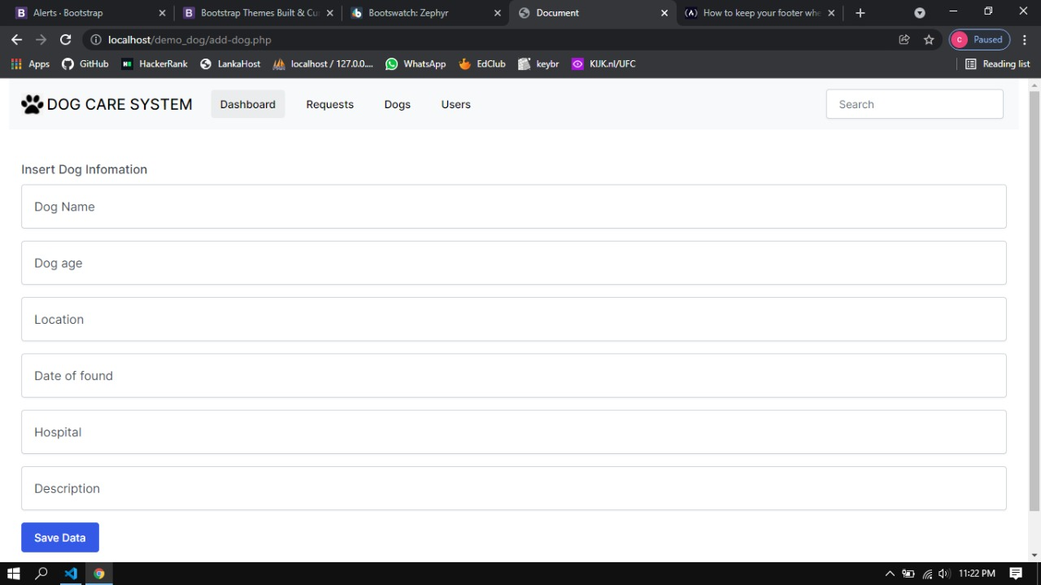

Slide 42
dog detail page

Slide 43
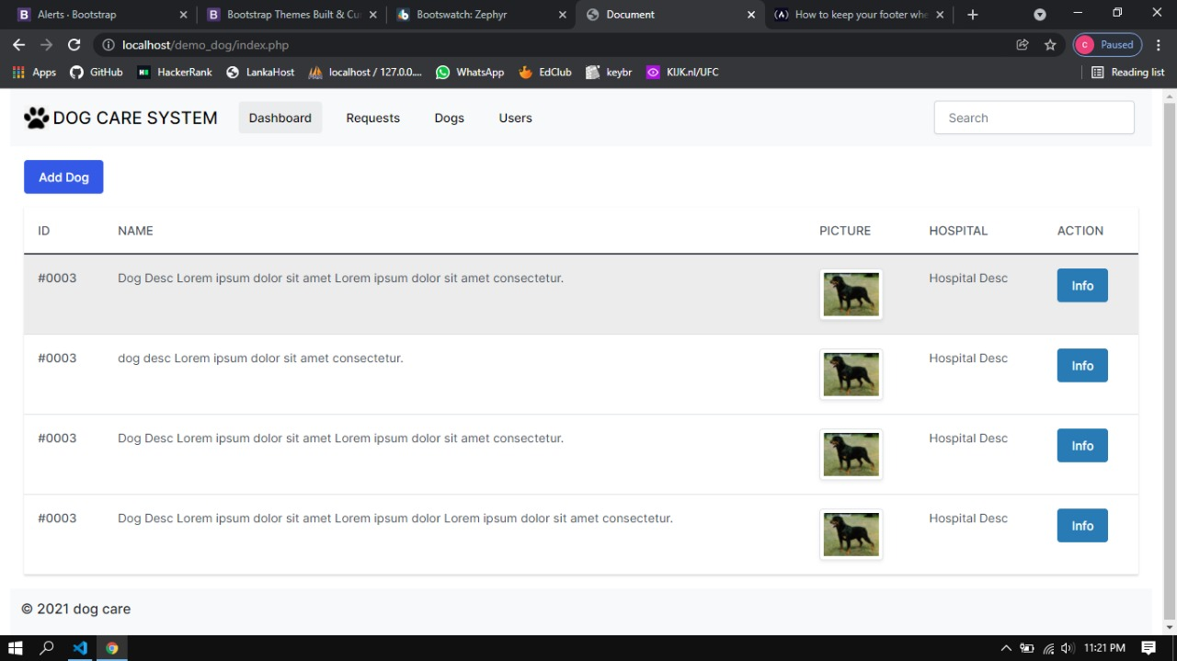

Slide 44
Request page

Slide 45
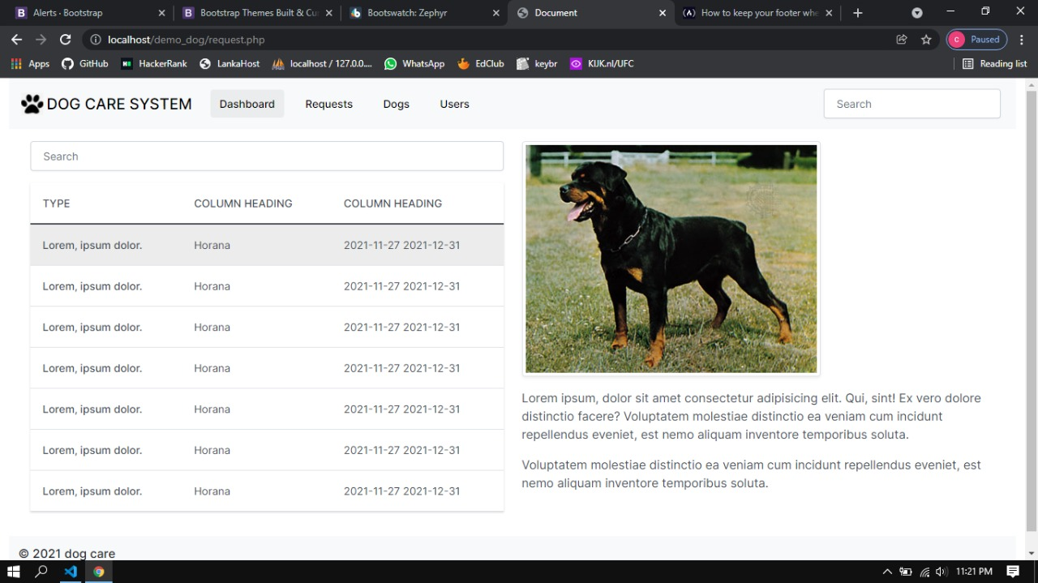

Slide 46
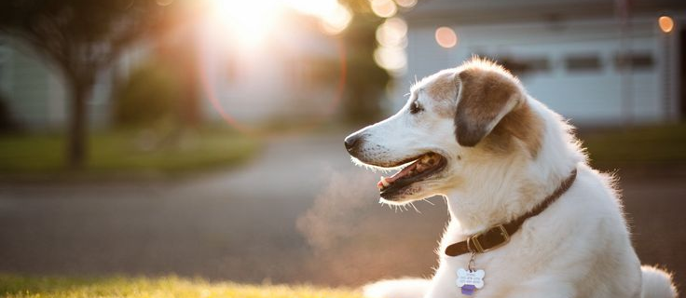
Summary
This Dog Care system has unique features than other systems. There is no App in Sri Lanka for dog rescue process so this app will solve that problem. We plan to upload our app to Google play store with help of Dogee organization and then we can get an idea about the users.
In this app we mainly focus on dog rescue process. We hope to add dog adoption phase and the selling phase in later versions.
We hope to add visualization to the data that we are collecting through the apps using grafana or superset. So then there will be more meaningful data in the dashboard.

Slide 47

Any Questions?????

Slide 48

Thank you
Erangi Wanniarachchi​​
88730442
erangiwanniarachchi21@gmail.com

